Slide 1
FX Payout process

Slide 2
1️⃣ Customer initiates outgoing EUR payment from GBP wallet
We request a quote from Convera API: POST /v3/quote
Convera returns: {
quote_id, rate, sell_amount (GBP), buy_amount (EUR), expiry
}
We store this in our database.

Slide 3
2️⃣ Customer confirms → We execute the FX trade
We call Convera API: POST /v3/executions
Convera locks the rate and returns:
• deal_id (EXEC1234)
• trade date
• buy/sell amounts
• settlement date
• payment booking id (if combined)
This is now a legally binding FX trade.

Slide 4
3️⃣ Treasury funds the trade
1. Convera sends us SI (MT103)
Pay 1,000 GBP to Convera Settlement a/c
Beneficiary: Convera Financial Services
IBAN: ***
BIC: ***
Reference: Settlement of deal EXEC1234
2. Treasury sends Convera the sell currency (GBP) from our nostro account GBP Treasury Nostro – Convera GBP Collection Account

Slide 5
4️⃣ Convera delivers the outgoing FX payout
Once they confirm receipt of our GBP:
Convera triggers the outbound EUR payment via SEPA:
Beneficiary sees the funds as:
From: Convera (on behalf of Frontier Pay)

Slide 6
5️⃣ Treasury ↔ Convera Reconciliation
🔹 FX Deal Execution Report
Daily schedule: /v3/reports/executions
🔹 Settlement Reports
Shows what Convera received from us (GBP inflows)
🔹 Payment Delivery Reports
Shows successful EUR outbound payments
🔹 Bank Statements
For our GBP Nostro, Treasury matches:
Deal EXEC123 → Outflow 1,000 GBP → Payout 1,1594.20 EUR → Payment delivered

Slide 7
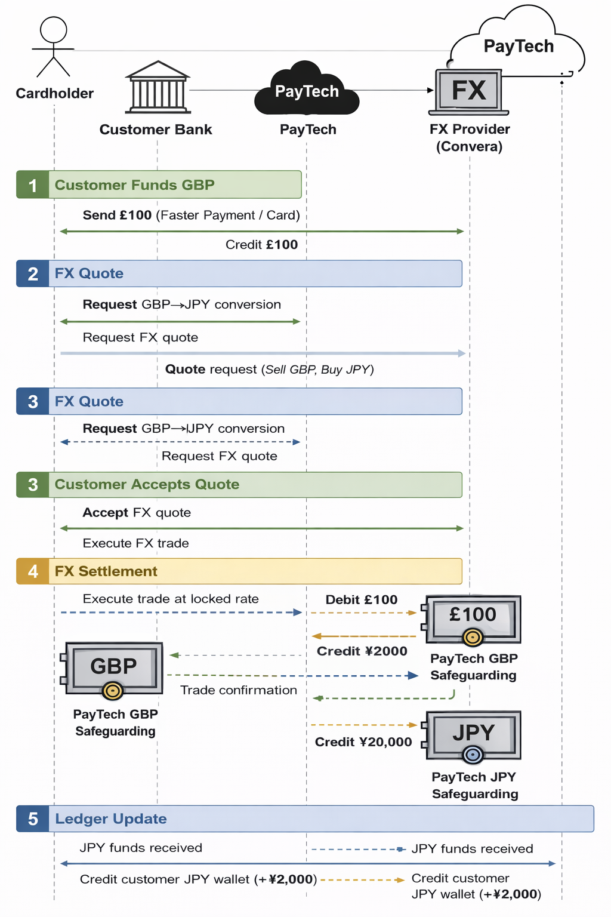

Slide 8
Payment Event Processing
Front-end
Service Provider
Virtual IBANs
API Gateway
Banking Circle
FX Services
GraphQL
REST
Account Management Service
User Service
Domestic Payments
Transaction Processing Service
Equals Money
User created
Transaction event
Notification Service
Middle Tier
Front End Services
Orchestrator
Card Service
Cross-border Payments
Funding events
Convera
Events
Connectors
FX Service
Settlement
DB Events
Authorisation events
Events
Payment Database
Bank of London
BACS, CHAPS, FPS
Ledger Service
Verify Identity
SEPA
Authentication Service
Card Processor
Cards Network
Supporting Layer
KYC Service
Fraud Detection Service
Analytics Service
Logging & Monitoring Service
Events
User Portal
Analytics Portal
Operation Portal

